Slide 1
Version Control
Using Git and GitHub

Slide 2
Introduction: What is Version Control?
Version control is a system that records changes to a file or set of files over time so that you can get/retrieve specific versions later
It allows you to revert selected files back to a previous state, the entire project back to a previous state, compare changes over time, see who last modified something that might be causing a problem, who introduced an issue and so on

Slide 3

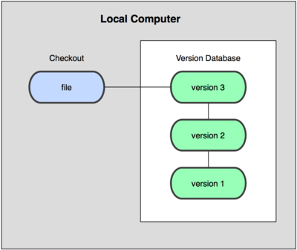
Introduction: Why Version Control?
Notes:
The screenshot on the left shows different versions but the versions are not controlled. The picture on the right shows what happens when there is version control

Slide 4
Exercise
Git downloads page :https://git-scm.com/download/win
https://git-scm.com/download/mac
Install git
Register on https://github.com

Slide 5
Familiarize yourself with the command line interface.. Thanks to Microsoft Windows, everything started from the command line!
Cd : change directory
dir , ls
dir /p
Copy and pasting into the cmd
Clear
Autocomplete of folder and file names
Using the up arrow key to bring back used commands

Slide 6
Git Workflow
Initialize: You instruct Git on which files and directories to track , the files and directories that are tracked is known as repository
Track: you need to specify that you want Git to track files that you add
Commit: a commit is like a photograph that records the current state of the files, you can go back to a certain commit at a later time.
Push: this refers to sending the changes you have made to your file to a remote location.

Slide 7
Git and Github
Github is a website that provides services that are related to git: it helps you manage your git-controlled projects
It allows users to put their Git repositories in the cloud and to perform Git-related operations through a web interface. It also provides Desktop and mobile apps that offer the same service
There are other websites like Github such as Bitbucket, Gitlab

Slide 8
Setting Up
After installing Git, you will need to define some global settings
  git config - -global user.name “buhari”
  git config - -global user.email buhari@moat.com
To check the list of all the configs, git config - -list
To edit any of the configuration settings, go to the ~/.gitconfig file (linux and mac) or C:users/<username>/.gitconfig (in Windows)
Git commands starts with the word ‘git’ followed by the command

Slide 9
Creating a git Project
Within the directory you want to track *, issue the command: git init
This will create a new directory, .git that stores the internals of git, its contents are always hidden from view. Any file you add/create to the directory is either tracked or untracked. Tracking is when Git monitors the changes being made to that file
git status tells you the state of your repository, revealing the tracked and untracked files.
Notes:
* Or type git init <project name> will create the folder project name and initialize it with an empty .git

Slide 10
Creating a git Project
In order to track the untracked files, use the command: git add file1 file2 file3 or you can run ” git add . “ to track the current directory as well as any file and sub-directories within that directory:
  git add –u will add all untracked files
Untracked files and uncommitted files are shown in red, when you add them to the repo, they are shown in green.
The .gitignore file: allows you hide certain files from being tracked by git
You simply include files you don’t want to track. For example: configurations/ *.exe you can even hide the .gitignore by including it also in the .gitignore file
To tell git to permanently record the changes in its history, type the command git commit –m “Your meaningful commit message here”

Slide 11
Exercise
Modify one of your tracked files, save it.
What command would you type to detect any new change in your repo?
Now, create (or copy) a new file within the repository.
Using git status, check what is shown.
Use the command, also make a change to an untracked file and use the command to see if the changes are recognized.
Use git add . again to add the new file to your repo and also to track the modifications in step 1 above

Slide 12
More git Commands
Git diff shows what has changed in the tracked file since the last commit.

Slide 13
2nd Session
Creating Branch from the head of the master branch
Creating Branch from a specific commit

Slide 14
More git Commands
Exercise: type git log in your command line, what do you see? How many versions do you have? How many times have you used the git commit command based on what is shown? Do you see the importance of giving a meaningful commit message?
Git log shows you the history of the project by letting you know the history of all commits. You will see the date, author and the unique id of all available commits on the files.
The 40 character string shown b6bd481… is the hash of the commit, or its identity generated automatically by Git
You can use a few string (5 0r 6 characters) from the 40-character git hash to refer to the respective commit.

Slide 15
Untracking Previously Tracked Files
Use of git add . Can unintentionally track the files you don’t want to track by mistake. Git will not show any error message, you will have to untrack the file(s)
To un-track previously-tracked files, do the following:
  Commit all your changes. Before proceeding, make sure all your changes are committed, including your .gitignore file.
  Then, remove everything from the repository. To clear your repo, use: git rm -r --cached <filename>

Slide 16
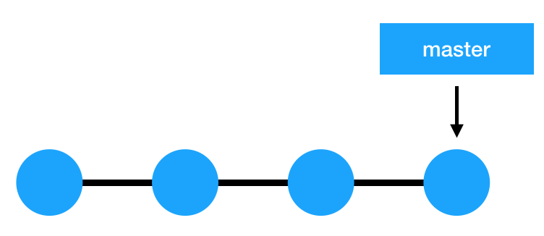
Branch in Git
A branch is just a link between different commits, or a pathway through the commits, it is simply a lightweight movable pointer to one of your commits.
The default branch name in Git is master. As you start making commits, you’re given a master branch that points to the last commit you made.
Every time you commit, the master branch pointer moves forward automatically.

Slide 17
Branches and HEAD
By default your repository has one branch named master which is considered to be the definitive branch.
The HEAD of a branch points to the latest commit in the branch – it is the tip of the commit
With a new commit added to a branch, the new commit forms the HEAD and the branch is said to be pointing to this new commit
Remember that a new branch is an offshoot of the latest commit. The master for the new branch will therefore be the last commit from which it was built.

Slide 18
Branching in Git
Creating a new branch in a project means creating a new copy of that project, you may want to experiment with a new copy of a project without affecting the original copy so that if the experiment fails, you can revert to this old copy. If the experiment is successful, you can easily incorporate it into the master. If you change your mind anytime, you can always revert to the original state before the merger.
Creating new branches/branching means you diverge from the main line of development and continue to do work without messing with that main line.
To create a new branch and stay in your current branch; git branch little_feature
In the above, little_feature is the newly created branch, when you run the command git branch, the current branch will be indicated by an asterisks. You can change to another branch by typing: git checkout little_feature (the checkout command)

Slide 19
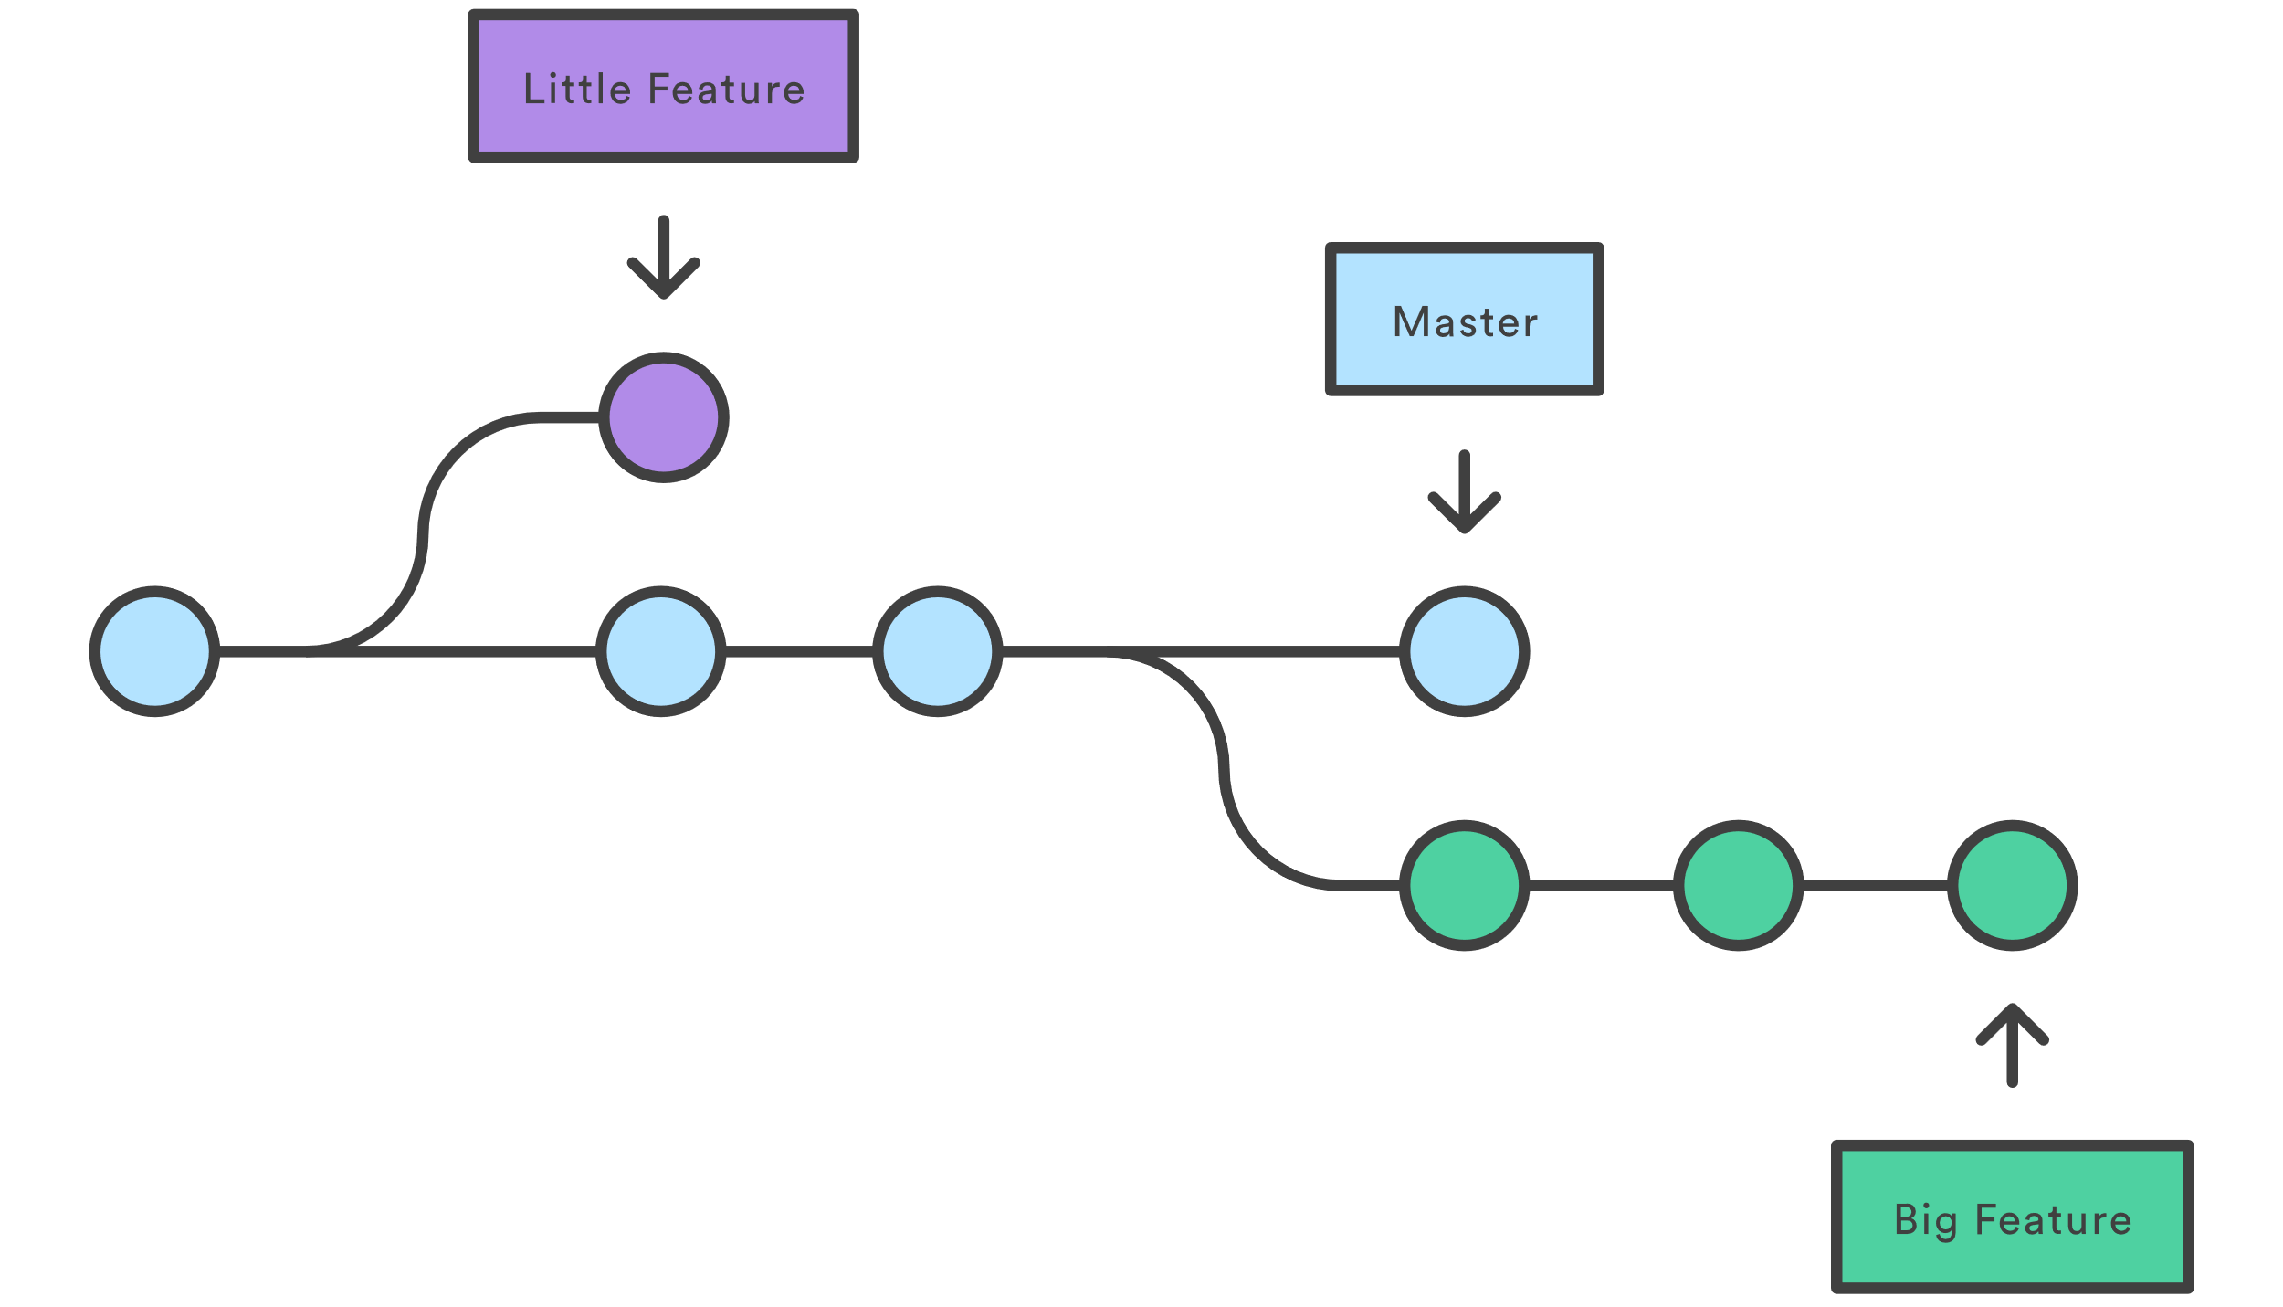

Slide 20
Branching in Git
To create and checkout at the same time, use the –b option: git checkout –b academic_branch
Note that the branch just created will be based on the latest commit of the current active branch.
To create a branch based on a certain commit, do: git checkout –b big_feature ca87456 by specifying the commit’s hash as shown above. *
To see all the branches that exist on your project, do git branch , git branch –a will show the local and remote branches
Notes:
See slide X for creating a local repo from a remote branch

Slide 21
Branching in Git
Note that when you create a branch, you have not changed the repository in any way, you have only added a new pointer to the repository
To start adding commits to it, you need to select it with git checkout, and then use the standard git add and git commit commands.
Notes:
See slide X for creating a local repo from a remote branch

Slide 22
3rd Session
Pushing To Remote Repository
Working in a Team using Git

Slide 23
Pushing your work to a remote repo
After saving your work locally , you may wish to push the same to a remote location such as github

Slide 24
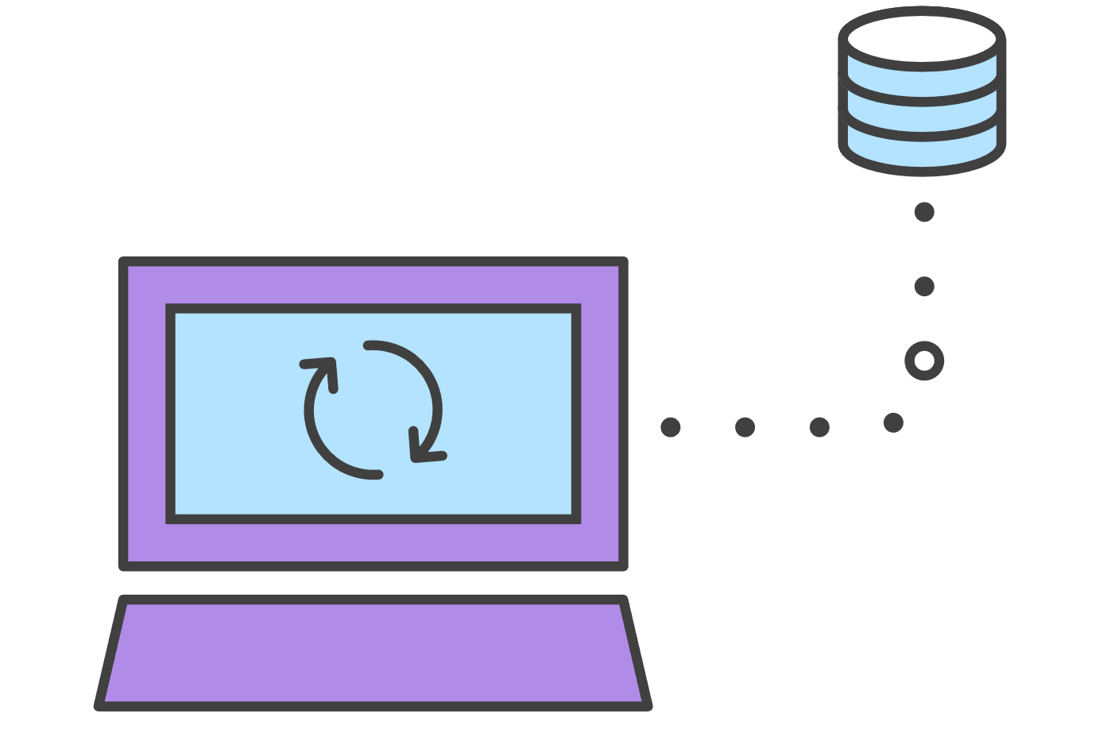
Pushing to a remote repository: The push command sends the commits from your local repository to the cloud repository.

Slide 25
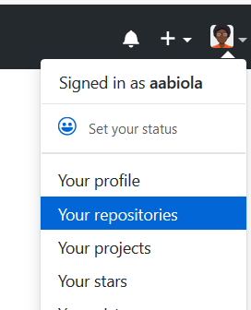
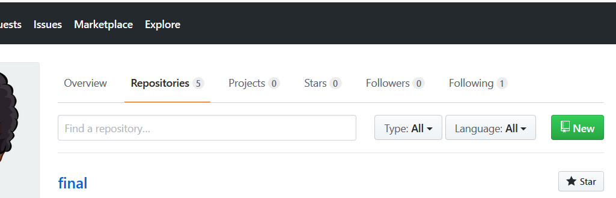
Pushing your work to a remote repo- create the remote repo
This repository you just created is regarded as ‘origin’

Slide 26
Pushing your work to a remote repo- create the remote repo
You may want to store a copy of your local repository in a remote location such as github
To set up this, you need to create an account on github and create the repository
To add your local repository to the remote repo, run the command:
  git remote add <name> <url> You will be able to use <name> as a convenient shortcut to refer to the remote address <url> (eg git remote add origin http://...)
  git push –u <name> <remotebranch> (eg git push –u origin master)
The second command with the –u option sets the remote (name) and its branch - (remotebranch) to be the upstream of the current local repo.
Better to be on the master branch before running this command

Slide 27
Pushing your work to a remote repo- create the remote repo
The –u option stands for “upstream” which links your local repo to an online/remote repo for future reference. When you add commit later, Git will show the status of your local repo with respect to the upstream
You can equally set the upstream for the current branch using the command git push --set-upstream <remotename> <remotebranch> eg git push --set-upstream online master
To push a newly created branch to the remote repository, you need to set the upstream.

Slide 28
Pushing Local Files to Remote Repositories
You need to have a write-access to the remote repository which you are uploading your files to*
Your local branches aren’t automatically synchronized to the remotes you write to — you have to explicitly push the branches you want to share.
Subsequently, after making changes to the project file locally, you need to synchronize it with the remote repository by running the push command: git push <repo-address> eg git push https://github.com/moatacad/weekend.git
Or when pushing to a specified branch git push <remotename> <branchname>
A git push pushes the code in the current branch to the origin remote branch of the same name
Notes:
You need to be added as a collaborator to a repo when it is not within your user account*

Slide 29
Starting a new Project by Cloning [a Particular branch] from remote repository
$ git clone -b <branchname> <repoURL> [<destinationFoldername>]
Example:
$ git clone -b master https://github.com/moatacad/project15.git
Notes:
destinationFoldername is optional,if not specified it will create a directory locally that is the same as the repo folder name online

Slide 30
Keeping yourself updated with git Pull
To update your local repository with the changes others have made, you need to download the new data and then merge it with the appropriate branches.
To download the changes that have appeared in the remote, run the following: git fetch <remote> to fetch all the branches and git fetch <remote> <branch> to fetch a specified branch
This updates our local branches from the remote <remote>, if the name of the remote is skipped and we run git fetch the command will update the branches of the local repository from the remote origin
When you clone a repository or set an upstream, local versions of their branches are also maintained. The fetch command updates these local versions with the latest commits from the remote.

Slide 31
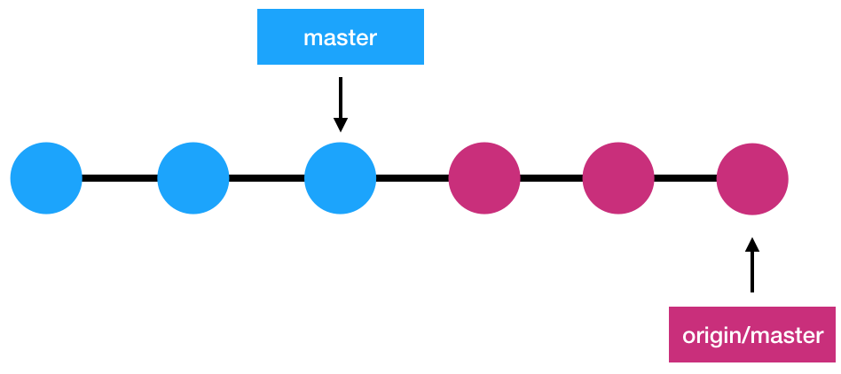
The master branch

Slide 32
Keeping yourself updated with git Pull
The fetch command will download the changed files, you then need to merge these changes into your local repository.
The master branch (or any other branch) of the remote repo is remotename/master eg origin/master as shown in the previous slide.
git merge origin/master will merge the branch origin/master with your current active branch after a fetch. Following the fetch, your origin/master is updated with the latest commits of the branch on the remote.

Slide 33
Keeping yourself updated with git Pull
A shorter way of updating a local branch via downloading and simultaneously merging of a remote branch is by using pull Run: git pull origin master
Git pull: simply downloads the code from the master branch of the origin remote branch. It then merges the code with the current active local branch.
Run git pull remote_name : first downloads the code from the master branch of remote_name remote branch and then merges the code with the current active branch.

Slide 34
Keeping yourself updated with git Pull
Run git pull <remote_name> <branch_name>: downloads the code from the branch_name branch of the remote_name remote branch. It then merges the code with the current active branch
A fetch-merge or pull may result into conflicts in which case it must be resolved before completing the merge or pull.
While in the repository to merge, type git merge remote/branch to merge the active repository to the remote name and branch.
Eg git merge origin/master

Slide 35
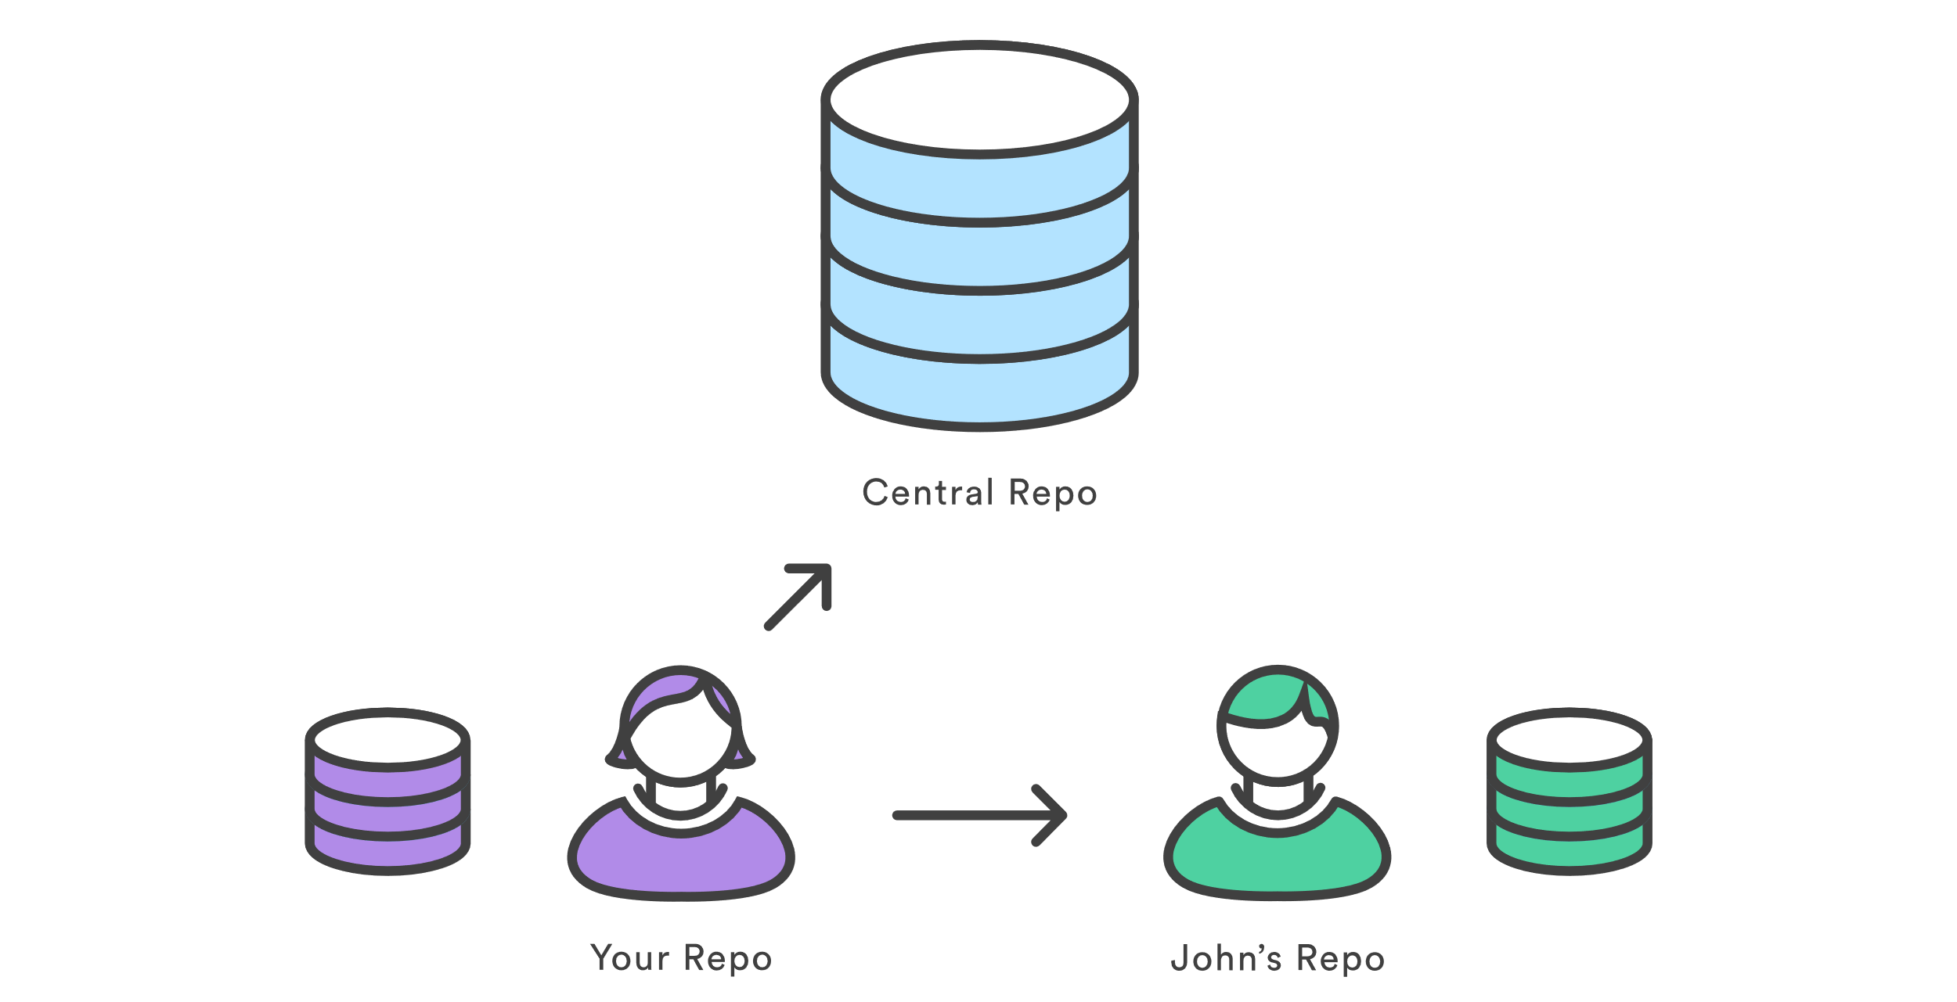
Keeping yourself updated with git Pull

Slide 36
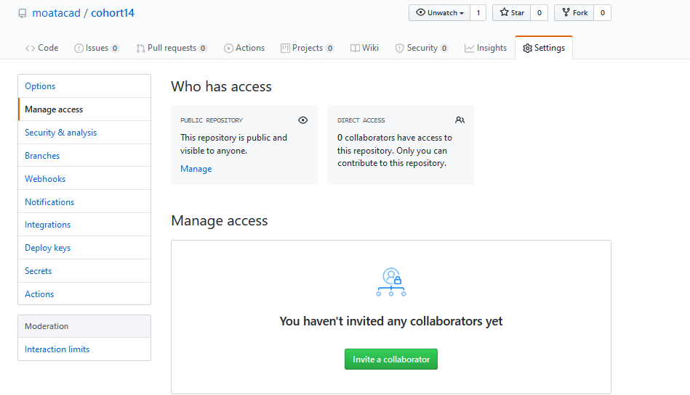
Working in a Team, you can invite collaborators to your project

Slide 37
Using Git in a Team
If you re working in a team, its possible that some work would have been done in the repository before you join, in this case you need first grab a copy from the central repository and work on it.
Cloning is the process of grabbing a copy from a central repository
When you clone a repository with git clone, it automatically (by default) creates a remote connection called origin pointing back to the cloned repository.
To clone a repository, you need to know its location (URL) and issue the command: git clone https://remoterepo.com/the-path-to-it.git

Slide 38
Using Git in a Team
A local directory is then created with the same name as the remote repo. You may specify another name for the directory as follows: git clone https://remoterepo.com/the-path-to-it.git newname
You may also rename the directory after you have cloned the repository.
To verify that the origin remote points to the URL that you just cloned from, run: git remote –v to see all the remote repositories linked to your local repo.
-v is short for - -verbose and tells git to display the URLs of the remotes next to the names.

Slide 39
More on Git Branching
To rename a branch: git branch –m new_name
To delete a branch, git branch –D branch_to_delete
Note, do not delete a branch unless you have to, it has no harm keeping a branch
The –D option deletes a branch even if it hasn’t been synchronized with a remote branch. If there are commits that have not been pushed, it will get deleted anyway. Using –d option only deletes a branch if it has been synchronized with a remote branch

Slide 40
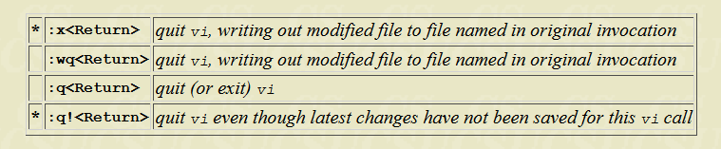
The git bash
Note: The cursor moves to bottom of screen whenever a colon (:) is typed. This type of command is completed by hitting the <Return> (or <Enter>) key.

Slide 41
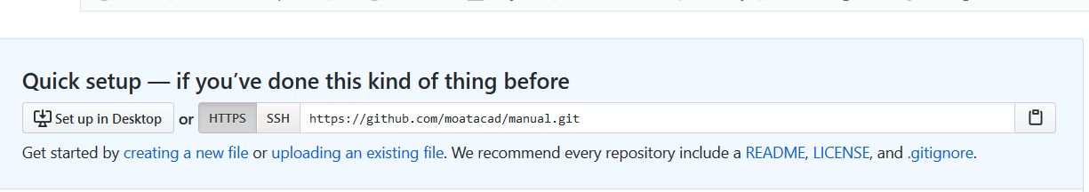
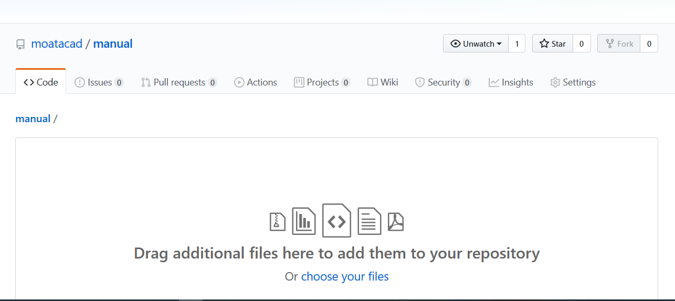
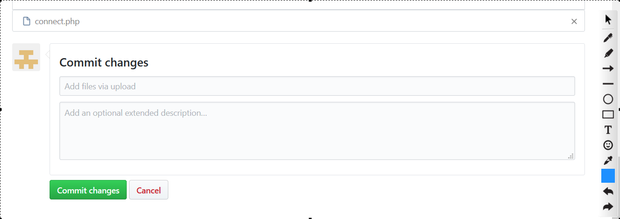
Github by GUI
Activities on github does not always have to be by command line, you may upload the files manually via GUI as well.

Slide 42
Github by GUI
Github provides a short documentation every time you create a repository online, see the next slide:

Slide 43
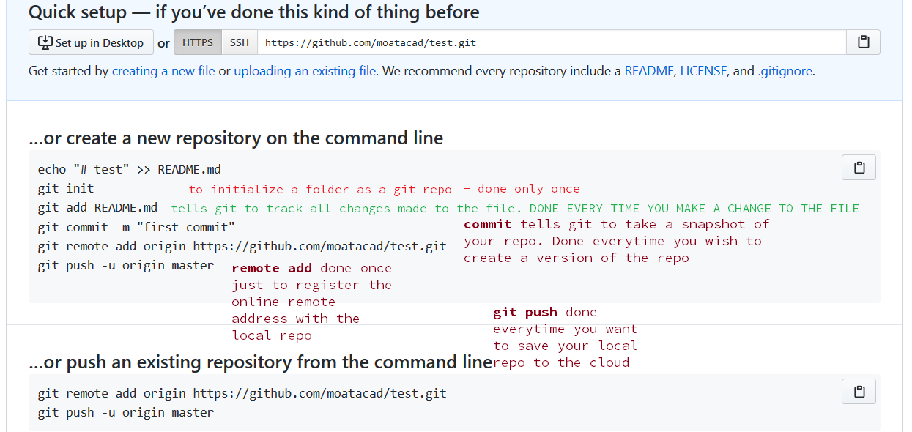

Slide 44
Miscellaneous
Resolving access denied error when the issue is that you have signed in to two different accounts using the same system and your system has kept a cache of your credentials.
What to do? Remove it! (in the search bar, type ‘credential manager ’ or go to Control Panel\User Accounts\Credential Manager)
See next slide

Slide 45
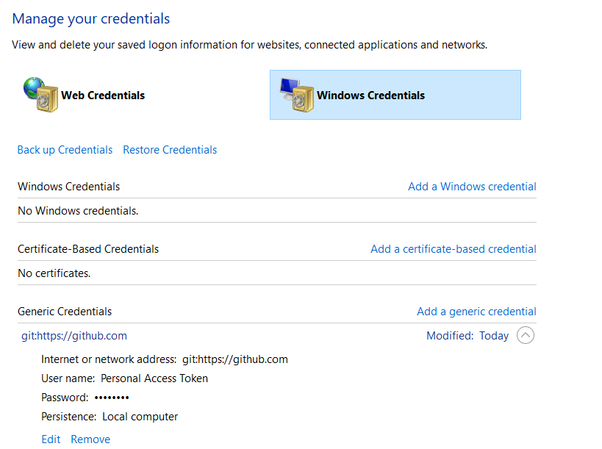

Slide 46
Removing Remote address
To remove remote use this: git remote remove origin
You can then re-add as previously done
Instead of removing and re-adding, you can do this:
git remote set-url origin git://new.url.here

Slide 47
PUSHING TO GITHUB – Personal Access Token
Github may require you authentication via Personal Access Token when cloning from github from a remote address like your local folder
Solution:
Set up a Personal Access token by going through: Profile/Settings/Developer Setting
Select Personal Access Tokens, Click on ‘Generate New Token’
Complete the form and Click on the button
When next you try to push to github, use the Personal access token in place of password

